Slide 1
Weather Forecast
Presented By : Project Guide :
Shivani Singh Mr.Harendra Singh
Negi

Slide 2
Content
Introduction
Project Aim
Project Specifications
Scenario Analysis
Use case diagram
U.I. diagram
Application output
Advantages
Limitation
Conclusion

Slide 3
Introduction
Weather forecasting is the use of science and technology to predict atmospheric conditions for a given location and time.
Weather forecasts are made by collecting quantitative data about the current state of the atmosphere at a given place and using meteorology to project how the atmosphere will change.
The prediction of atmospheric conditions such as temperature, humidity, dew point, rainfall, and wind speed on a specific location is known as weather forecasting.
Weather data is not only necessary for researchers or scientists, ordinary people can be benefitted from it as well.

Slide 4
Project Aim
To make a real time weather application that takes user’s exact location and provides weather forecast for the day and upcoming days also.
We also tried to design a simple but visual UI that provides comprehensive data. Also,the application provides suggestions to users based on weather conditions. And lastly, user can search and access data for custom locations(string based).

Slide 5
Project Specifications
Real time weather forecasting.
Platform: Windows.
IDE: VS Code.
Language: HTML, CSS, Java Script
Takes user’s geolocation as input to provide weather forecast
Hyper-Local Forecast: App will predict rain,storm and weather changes with a per minute accuracy based on the user current location.
Can also take custom location as input to provide weather details for that location (Google Manual Search API).It is string based basically,but it provides data for every city.
REST API used to fetch data from www.openweathermap.org for live weather report.

Slide 6
Scenario Analysis
Screen and Interaction Analysis: The users can visit this website on laptops and tablets. All the information of this website will be displayed full screen. Basically, the interactions include touch and click and scroll. For example, when users would like to view weather information, they click the icon to open this website; when they want to add a new city, they click the add icon and type in the city that they want.
Usage Analysis: Users can open this website whenever they want, every day at home, on their way to travel, and other situations as long as they want to know weather information.

Slide 7
C. Environment Analysis: This website can be used on smartphones and tablet devices. It will be using the Openweather API to get the weather information. It sends requests, and then get responses from the API through the internet.Uses Google APIs for geolocation and keyword based search purposes(City details).

Slide 8
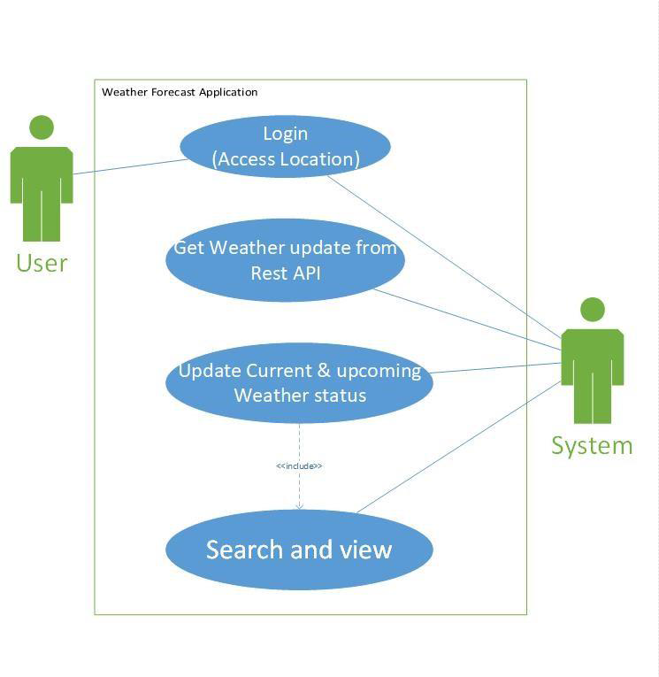
Use-Case Diagram

Slide 9
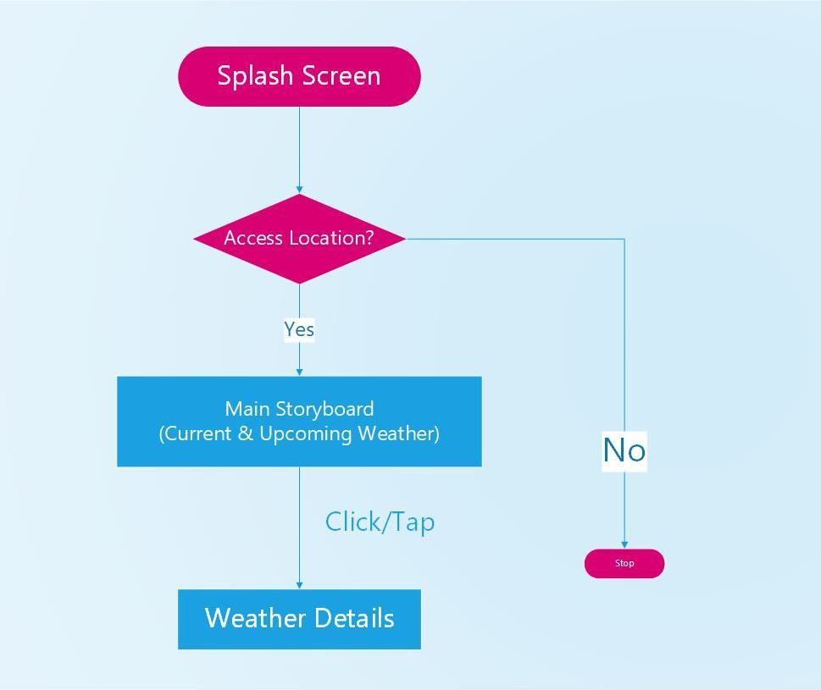
U.I Diagram

Slide 10
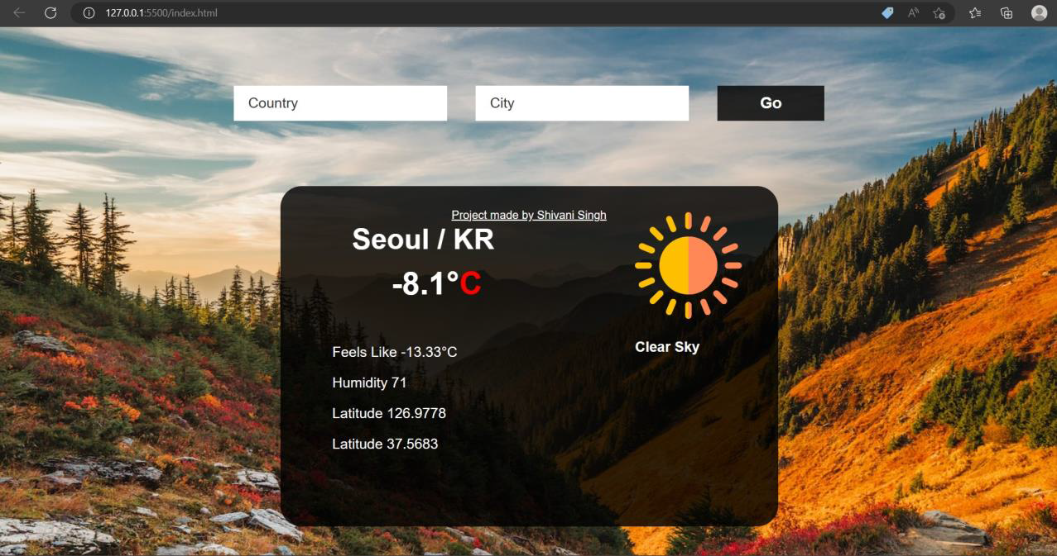
Application Output

Slide 11
Advantages
Farmers can known when to plant or harvest their crops
People can choose where and when to take their holidays to take advantage of good weather.
Surfers know when large waves are expected.
Regions can be evacuated if hurricanes or floods are expected.
Aircraft and shipping rely heavily on accurate weather forecasting.
The user can see different satellite images of clouds, temperature, precipitation, and wind patterns to understand the forecast in a better way.

Slide 12
Limitations
Unpaid APIs provide incomplete services.Many details cannot be fetched
Often,tuples of upcoming days remain empty once again due to free APIs
The GMS API ( Google Manual Search) is actually keyword based that might only provide data of few discrete locations.The data might not be precise and continuous.
Language diversity could have been implemented.

Slide 13
Conclusion
•Weather forecasting is a complex and challenging science that depends on the efficient interplay of weather observation, data analysis by meteorologists and computers, and rapid communication systems.
•Meteorologists have achieved a very respectable level of skill for short range weather forecasting.
•Further improvement is expected with denser surface and upper air observational networks, more precise numerical models of the atmosphere, larger and faster computers and more are to be realized.
•However, continued international cooperation is essential, for the atmosphere is a continuous fluid that knows no political boundaries.

Slide 14
References
1. https://openweathermap.org/appid
2. www.wikipedia.com
3. www.github.com
4. https://getrevising.co.uk/grids/weather-forecasting
5. https://ieeexplore.ieee.org/document/9596117

Slide 15
Thank You

